Slide 1
Transfer Learning

Slide 2
How much data do we need?
Model | Dataset | Volumn
YoloV3 | COCO | 200k++ images
BERT | BookCorpus | 74M sentences (1G words)
EfficientNet | ImageNet | 1M images
Ref: https://paperswithcode.com/sota/image-classification-on-imagenet?tag_filter=5

Slide 3
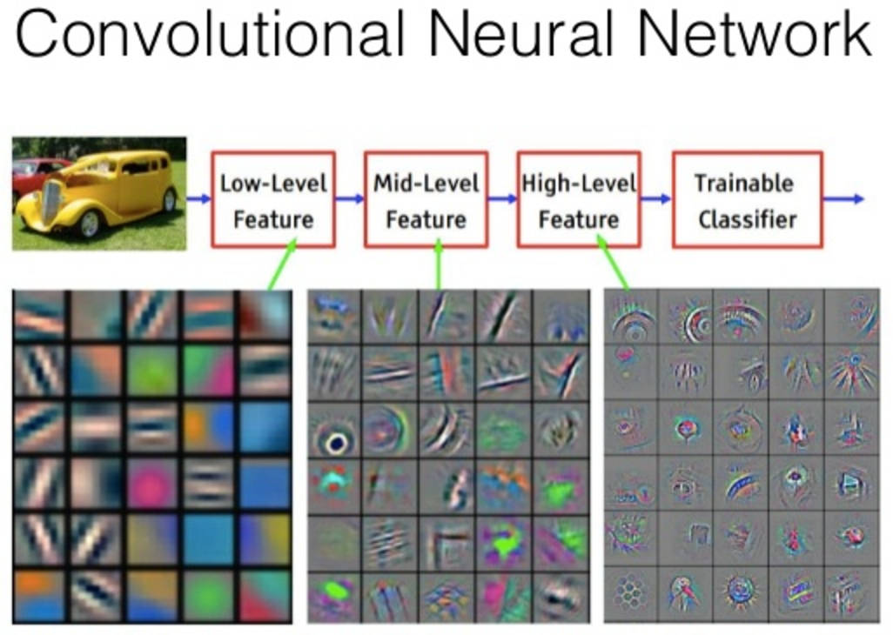
Situation A
In 2020 @Google HQ
Situation A : Detect Vintage car please!!!
Result: Vin model(นามสมมติ อย่าฟ้องชั้น)
With 1M image of Vintage car pics
This model(Vin model) went public

Slide 4

Situation B
In 2021 @Ajarn Peerapon Lab
Situation B: We need to detect modern car like Honda or Toyota
What should we do??
Me

Slide 5

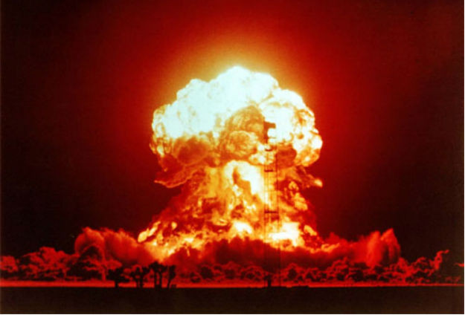

Traditional way (Old method)
Ajarn Peerapon
But HOW?????
Me
Get me 1M of modern car picture and label it!!!

Slide 6
Solution : Transfer learning!!!!!!(1)
In Vin-Model
Volkswagen
It just a line detector
It just a wheel detector
Me
Let’s use some of these features in our model

Slide 7
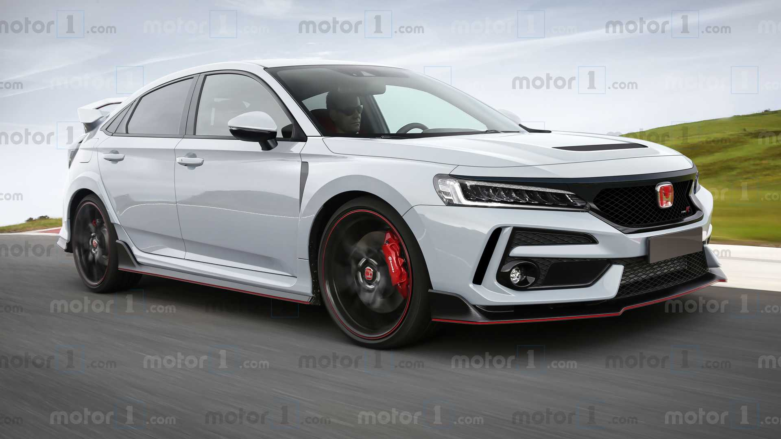

Transfer learning(2)
New training set
Same Old low-mid layer
New Classifier
In Modern-Model
Modern car classifier (Random initial weights)
Toyota???(Low confidence)
Me
Training Time!!!!!!
มูด้าๆๆๆๆ GPU กรีดร้อง ไปอีกพักใหญ่
Let’s use some of these features in our model

Slide 8
Transfer learning(3)
New training set
Same Old low-mid layer
New Classifier
In Modern-Model
Modern car classifier (Perfect weights)
Honda
Use least time to train and much smaller dataset

